Slide 1
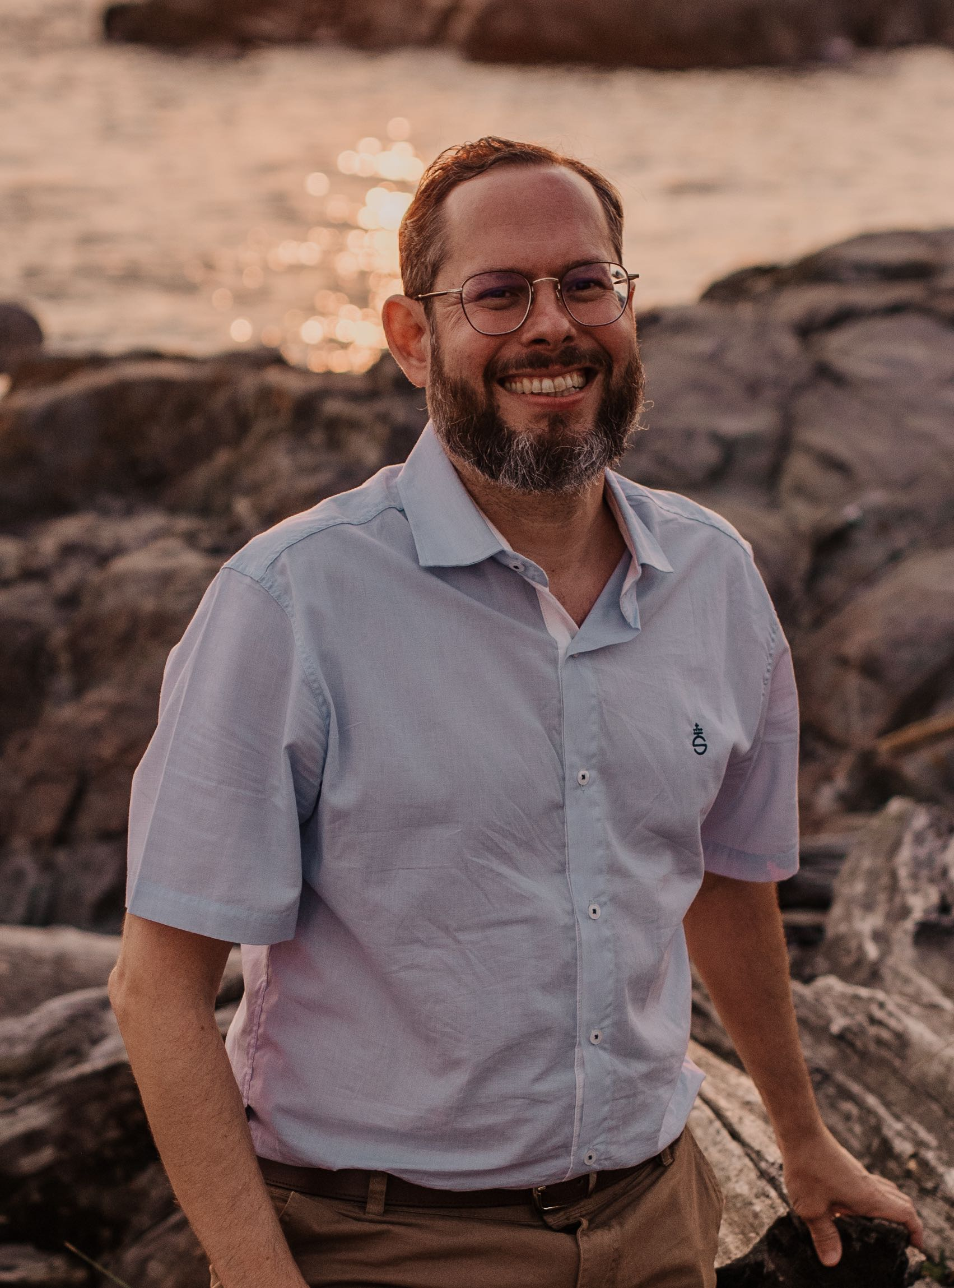





Quantum BC Seminar Series
Tuesday, September 12, 2023 at 2pm BC Time
Join in Person:
UBC: MCLD Room 3038
SFU: SCP 8445.2
UVIC: ELL 230
Join on Zoom:
https://ubc.zoom.us/j/69443327772?pwd=TGhhTXFIQ3ZiUmNrN0pUa3FObTNydz09
Meeting ID: 694 4332 7772
Passcode: 996727
For more info:
bahiyyih.peters@ubc.ca
The Quantum BC Seminar Series happens on the second Tuesday of every month at 2pm
Dr. Rogério de Sousa
Professor, Department of Physics and Astronomy, University of Victoria
Seminar Title: Noise in Chip-Based Quantum Computers

